Slide 1
Fall, 2021
Lecture 02: Derivatives

Slide 2
Contents
1
Two historical problems of calculus
2
Tangent line and Rate of change
3
The Derivative of a function
4
Rules of Differentiation
5
Derivaties of Trigonometric Functions
6
The Chain Rule

Slide 3
TWO HISTORICAL PROBLEMS OF CALCULUS

Slide 4
Two historical problems of calculus
Historically, the development of calculus by Isaac Newton and Gottfried W. Leibniz resulted from the investigation of the following problems:
Finding the tangent line to a curve at a given point on the curve:
y
T
t

Slide 5
Two historical problems of calculus
Historically, the development of calculus by Isaac Newton and Gottfried W. Leibniz resulted from the investigation of the following problems:
Finding the area of planar region bounded by an arbitrary curve.
y
R
x

Slide 6
Two historical problems of calculus
The study of the tangent-line problem led to the creation of differential calculus, which relies on the concept of the derivative of a function.
The study of the area problem led to the creation of integral calculus, which relies on the concept of the anti-derivative, or integral, of a function.

Slide 7
tangent lines and
rates of change

Slide 8
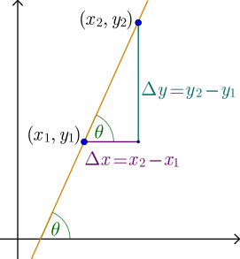
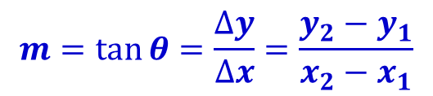
Slope of a line
Slope of a line is a number that describes both the direction and the steepness of the line.
$$m=\tan{θ=\frac{∆y}{∆x}=\frac{y_{2}−y_{1}}{x_{2}−x_{1}}}$$

Slide 9
Slope at a point of a curve
For a curve, we consider the slope at a point which is given by the slope of the tangent to the curve at that point.
y
Suppose we want to find the slope at point A.
A
The tangent line has the same slope as the curve does at point A.
x

Slide 10
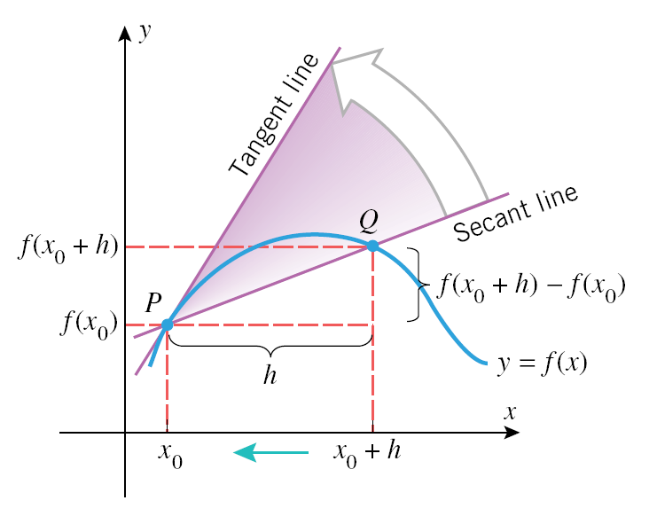
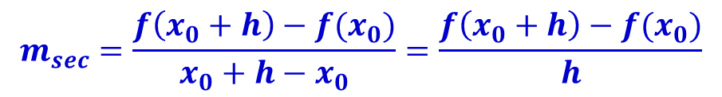
Slope of a tangent line at a point of a curve
Consider a tangent line and a secant line in the picture.
In general, we can express the slope of the secant as follows:
$$m_{sec}=\frac{f\left(x_{0}+h\right)−f(x_{0})}{x_{0}+h−x_{0}}=\frac{f\left(x_{0}+h\right)−f(x_{0})}{h}$$

Slide 11
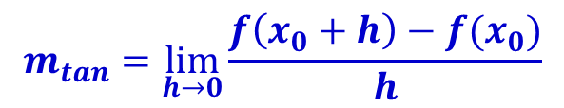
Slope of a tangent line at a point of a curve
Thus, as h approaches zero, the slope of the secant approaches the slope of the tangent to the curve at that point
$$m_{tan}=\lim_{h→0}{\frac{f\left(x_{0}+h\right)−f(x_{0})}{h}}$$

Slide 12
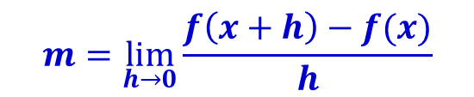
Slope of a tangent line at a point of a curve
The slope of the tangent line to the graph of f at the point P(x, f(x)) is given by:
if it exists.
$$m=\lim_{h→0}{\frac{f\left(x+h\right)−f(x)}{h}}$$

Slide 13

Average Rates of Change
We can see that measuring the slope of the tangent line to a graph is mathematically equivalent to finding the rate of change of f at x.
The number f(x + h) – f(x) measures the change in y that corresponds to a change h in x.
Then the difference quotient measures the average rate of change of y with respect to x over the interval [x, x + h].
$$\frac{f\left(x+h\right)−f(x)}{h}$$

Slide 14
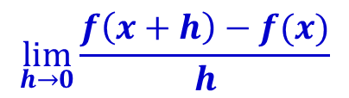
Instantaneous Rates of Change
By taking the limit of the difference quotient as h goes to zero, evaluating we obtain the rate of change of f at x.
This is known as the instantaneous rate of change of f at x (as opposed to the average rate of change).
This limit is called the derivative of f at x.
$$\lim_{h→0}{\frac{f\left(x+h\right)−f(x)}{h}}$$

Slide 15
THE DERIVATIVE OF A FUNCTION

Slide 16
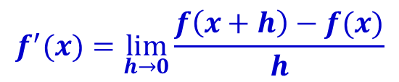
The Derivative of a Function
The derivative of a function f with respect to x is the function f’ (read “f prime”).
The domain of f′ is the set of all x where the limit exists.
$$f^{′}(x)=\lim_{h→0}{\frac{f\left(x+h\right)−f(x)}{h}}$$
The derivative of function f is a function f ′ that gives the slope of the tangent to the line to the graph of f at any point (x, f(x)) and also the rate of change of f at x.
Page 16

Slide 17

The Derivative of a Function
Four step process for finding f’
Compute f(x+h)
Form the difference f(x + h) – f(x)
Form the quotient
Compute
$$\frac{f\left(x+h\right)−f(x)}{h}$$
$$f^{′}(x)=\lim_{h→0}{\frac{f\left(x+h\right)−f(x)}{h}}$$

Slide 18

The Derivative of a Function: Example
Find the slope of the tangent line to the graph f(x) = x² at the point (2, 4).
Solution:
The slope of the tangent line at any point is given by the derivative of f at x.
To find the derivative, we use the four-step process:
Step 1. f(x + h) = (x + h)² = x² + 2xh + h².
Step 2. f(x + h) – f(x) = x² + 2xh + h² – x² = h(2x + h).
Step 3.
Step 4.
$$\frac{f\left(x+h\right)−f(x)}{h}=\frac{h(2x+h)}{h}=2x+h$$
$$f^{′}(x)=\lim_{h→0}{\frac{f\left(x+h\right)−f(x)}{h}=\lim_{h→0}\left(2x+h\right)=2x}$$

Slide 19

The Derivative of a Function: Example
Find the slope of the tangent line to the graph f(x) = x² at the point (2, 4).
Solution:
The slope of the tangent line at the point (2,4) is:
y
$$f^{′}\left(2\right)=2∗2=4$$
(2, 4)

Slide 20
RULEs of Differentiation

Slide 21
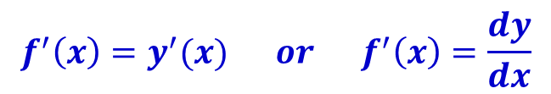
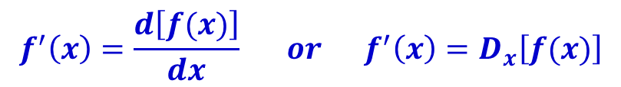
Differentiation
The process of finding a derivative is called differentiation. It is an operation on functions that associates a function f’ with a function f.
We use the differentiation notation:
In the case where there is a dependent variable y=f(x), then:
The following rules are developed to simplify the differentiation process.
$$f^{′}\left(x\right)=\frac{d\left[f(x)\right]}{dx} or f^{′}\left(x\right)=D_{x}\left[f(x)\right]$$
$$f^{′}\left(x\right)=y^{′}(x) or f^{′}\left(x\right)=\frac{dy}{dx}$$

Slide 22
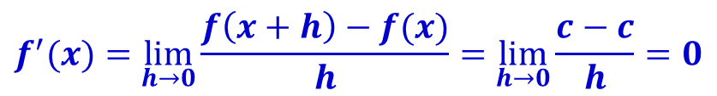

Rules of Differentiation
Rule 1: Derivative of a constant
The derivative of a constant function is equal to zero.
We can use the definition of the derivative to demonstrate this:
$$\frac{d}{dx}\left(c\right)=0$$
$$f^{′}(x)=\lim_{h→0}{\frac{f\left(x+h\right)−f(x)}{h}=\lim_{h→0}{\frac{c−c}{h}=0}}$$

Slide 23
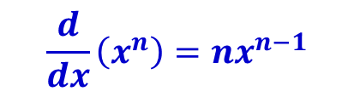
Rules of Differentiation
Rule 2: The power rule
n is any real number
See textbook for the proof of this theorem when n is a positive integer.
$$\frac{d}{dx}\left(x^{n}\right)=nx^{n−1}$$

Slide 24
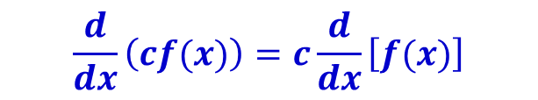
Rules of Differentiation
Rule 3: Constant multiple rule
If c is any constant real number, then
See textbook for the proof of this theorem.
$$\frac{d}{dx}\left(cf(x)\right)=c\frac{d}{dx}\left[f(x)\right]$$

Slide 25
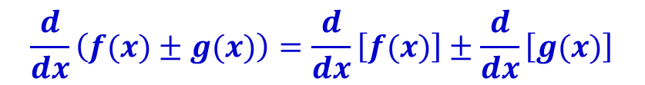
Rules of Differentiation
Rule 4: The sum rule
See textbook for the proof of this theorem.
$$\frac{d}{dx}\left(f(x)±g(x)\right)=\frac{d}{dx}\left[f(x)\right]±\frac{d}{dx}\left[g(x)\right]$$

Slide 26
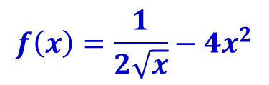

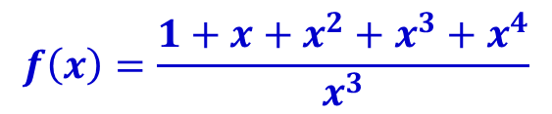
Rules of Differentiation: Example
Find the derivative of:
$$f\left(x\right)=x^{3}+5$$
$$f\left(x\right)=\frac{1}{2\sqrt{x}}−4x^{2}$$
$$f\left(x\right)=\frac{1+x+x^{2}+x^{3}+x^{4}}{x^{3}}$$

Slide 27

Rules of Differentiation: Example
Solution:
We use rule 4, rule 2 and rule 1
$$f^{′}\left(x\right)={\frac{d}{dx}(x}^{3}+5)=\frac{d}{dx}\left(x^{3}\right)+\frac{d}{dx}\left(5\right)=3x^{2}+0=3x^{2}$$
$$f^{′}\left(x\right)=\frac{d}{dx}\left(\frac{1}{2\sqrt{x}}−4x^{2}\right)=\frac{1}{2}\frac{d}{dx}\left(x^{−\frac{1}{2}}\right)−4\frac{d}{dx}\left(x^{2}\right)$$
$$=\frac{1}{2}\left(−\frac{1}{2}\right)x^{\left(−\frac{1}{2}−1\right)}−4.\left(2x\right)=−\frac{1}{4}x^{−\frac{3}{2}}−8x$$
$$=−\frac{1}{4x^{\frac{3}{2}}}−8x=−\frac{1}{4x\sqrt{x}}−8x$$

Slide 28

Rules of Differentiation: Example
Solution:
$$f^{′}\left(x\right)=\frac{d}{dx}\left(\frac{1+x+x^{2}+x^{3}+x^{4}}{x^{3}}\right)$$
$$=\frac{d}{dx}\left(\frac{1}{x^{3}}\right)+\frac{d}{dx}\left(\frac{1}{x^{2}}\right)+\frac{d}{dx}\left(\frac{1}{x}\right)+\frac{d}{dx}\left(1\right)+\frac{d}{dx}(x)$$
$=\frac{d}{dx}\left(x^{−3}\right)+\frac{d}{dx}\left(x^{−2}\right)+\frac{d}{dx}\left(x^{−1}\right)+0+1$
$$=−3x^{−4}−2x^{−3}−x^{−2}+1=−\frac{3}{x^{4}}−\frac{2}{x^{3}}−\frac{1}{x^{2}}+1$$

Slide 29

Rules of Differentiation: Applied Example
A group of biologists at the Cúc Phương forest recommended that a series of conservation measures be carried out over the next decade to save a certain species of monkey from extinction.
After implementing the conservation measure, the population of this species is expected to be: where N(t) denotes the population at the end of year t.
Find the rate of growth of the monkey population when t = 2 and t = 6?.
How large will the monkey population be 8 years after implementing the conservation measures?
$$N\left(t\right)={3t}^{3}+{2t}^{2}−10t+600$$

Slide 30



Rules of Differentiation: Applied Example
Solution:
The rate of growth of the monkey population at any time t is given by:
In particular, for t = 2, we have:
And for t = 6, we have:
Thus, the monkey population’s rate of growth will be 34 monkeys per year after 2 years and 338 monkeys per year after 6 years.
$${N(t)}^{′}={9t}^{2}+4t−10$$
$${N(2)}^{′}={9(2)}^{2}+4\left(2\right)−10=34$$
$${N(6)}^{′}={9(6)}^{2}+4\left(6\right)−10=338$$

Slide 31
Rules of Differentiation: Applied Example
Solution:
The monkey population at the end of the eighth year will be :
$$N\left(8\right)={3\left(8\right)}^{3}+2{\left(8\right)}^{2}−10\left(8\right)+600=2184 monkeys$$

Slide 32
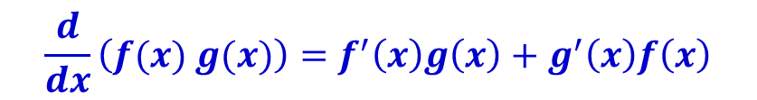
Rules of Differentiation
Rule 5: The product rule
The derivative of the product of two differentiable functions is given by
See textbook for the proof of this theorem.
$$\frac{d}{dx}\left(f(x) g(x)\right)=f^{′}\left(x\right)g\left(x\right)+g^{′}\left(x\right)f\left(x\right)$$

Slide 33
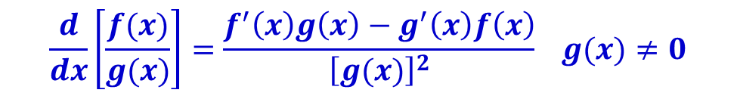
Rules of Differentiation
Rule 6: The quotient rule
The derivative of the quotient of two differentiable functions is given by
See textbook for the proof of this theorem.
$$\frac{d}{dx}\left[\frac{f(x)}{g(x)}\right]=\frac{f^{′}\left(x\right)g\left(x\right)−g^{′}\left(x\right)f\left(x\right)}{{\left[g(x)\right]}^{2}} g(x)≠0$$

Slide 34



Rules of Differentiation: Example
Find the derivative of:
$$f\left(x\right)=\left({2x}^{2}−1\right)\left(x^{3}+3\right)$$
$$f\left(x\right)=x^{3}\left(\sqrt{x}+1\right)$$
$$f\left(x\right)=\frac{x^{2}+1}{x^{2}−1}$$

Slide 35


Rules of Differentiation: Example
Solution:
$$f\left(x\right)=\left({2x}^{2}−1\right)\left(x^{3}+3\right)$$
$$f^{′}\left(x\right)=\left(2x^{2}−1\right)\frac{d}{dx}\left(x^{3}+3\right)+\left(x^{3}+3\right)\frac{d}{dx}\left(2x^{2}−1\right)$$
$$=\left({2x}^{2}−1\right)\left({3x}^{2}\right)+\left(x^{3}+3\right)\left(4x\right)$$
$$=10x^{4}−3x^{2}+12x$$

Slide 36


Rules of Differentiation: Example
Solution:
$$f\left(x\right)=x^{3}\left(\sqrt{x}+1\right)$$
$$f^{′}\left(x\right)=\left(x^{3}\right)\frac{d}{dx}\left(x^{\frac{1}{2}}+1\right)+\left(x^{\frac{1}{2}}+1\right)\frac{d}{dx}\left(x^{3}\right)$$
$$=\left(x^{3}\right)\left({\frac{1}{2}x}^{−\frac{1}{2}}\right)+\left(x^{\frac{1}{2}}+1\right)\left(3x^{2}\right)$$
$$=\frac{7}{2}x^{\frac{5}{2}}+3x^{2}=\frac{7x^{2}\sqrt{x}}{2}+3x^{2}$$

Slide 37


Rules of Differentiation: Example
Solution:
$$f\left(x\right)=\frac{x^{2}+1}{x^{2}−1}$$
$$f^{′}\left(x\right)=\frac{\left(x^{2}−1\right)\frac{d}{dx}\left(x^{2}+1\right)−\left(x^{2}+1\right)\frac{d}{dx}\left(x^{2}−1\right)}{{\left(x^{2}−1\right)}^{2}}$$ $$=\frac{\left(x^{2}−1\right)\left(2x\right)−\left(x^{2}+1\right)\left(2x\right)}{{\left(x^{2}−1\right)}^{2}}$$
$$=\frac{−4x}{{\left(x^{2}−1\right)}^{2}}$$

Slide 38

Rules of Differentiation: Applied Example
Rate of Change of DVD Sales
The sales ( in millions of dollars) of DVDs of a hit movie t years from the date of release is given by:
Find the rate at which the sales are changing at time t?
How fast are the sales changing at:
The time the DVDs are released (t = 0)?
And two years from the date of release (t = 2)?
$$S\left(t\right)=\frac{5t}{t^{2}+1}$$

Slide 39

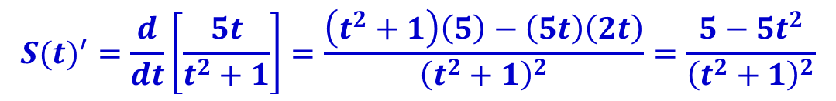

Rules of Differentiation: Applied Example
Solution:
The rate of change at which the sales are changing at time t is given by
In particular, the rate of change at which the sales are changing when the DVDs are released (t = 0) is: That is, sales are increasing by $5 million per year.
The rate of change two years after the DVDs are released (t = 2) is: That is, sales are decreasing by $600,000 per year.
$${S(t)}^{′}=\frac{d}{dt}\left[\frac{5t}{t^{2}+1}\right]=\frac{\left(t^{2}+1\right)\left(5\right)−\left(5t\right)\left(2t\right)}{{\left(t^{2}+1\right)}^{2}}=\frac{5−5t^{2}}{{\left(t^{2}+1\right)}^{2}}$$
$${S(0)}^{′}=5$$
$${S(2)}^{′}=−0.6$$

Slide 40
DERIVATIVES OF TRIGONOMETRIC FUNCTIONS

Slide 41
Self Learning
Read textbook Chapter 2, Section 2.5 – Derivatives of trigonometric functions (page 169-171).

Slide 42
The chain rule

Slide 43



Find derivative of composite function
Consider function h(x)
To compute h′(x), we can first expand h(x)
and, then evaluate the derivative
But how should we derive a function like H(x)?
$$h\left(x\right)={\left(x^{2}+x+1\right)}^{2}$$
$$h\left(x\right)={\left(x^{2}+x+1\right)}^{2}=x^{4}+2x^{3}+3x^{2}+2x+1$$
$$h^{′}\left(x\right)=4x^{3}+6x^{2}+6x+2$$
$$H\left(x\right)={\left(x^{2}+x+1\right)}^{100}$$

Slide 44


Find derivative of composite function
$$H\left(x\right)={\left(x^{2}+x+1\right)}^{100}$$
Note that is a composite function
H(x) is composed of two simpler functions
So that,
We can use this to find the derivative of H(x).
$$f\left(x\right)=x^{2}+x+1 and g\left(x\right)=x^{100}$$
$$H\left(x\right)=g\left[f(x)\right]={\left[f(x)\right]}^{100}={\left(x^{2}+x+1\right)}^{100}$$

Slide 45


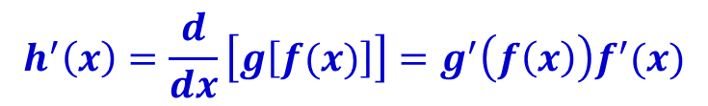
The Chain Rule
Rule 7: The chain rule
If , then
Or equivalently, if we write y = h(x) = g(u),
where u = f(x), then
See textbook for the proof of this theorem.
$$h\left(x\right)=g\left[f(x)\right]$$
$$h^{′}\left(x\right)=\frac{d}{dx}\left[g\left[f(x)\right]\right]=g^{′}\left(f\left(x\right)\right)f^{′}(x)$$
$$\frac{dy}{dx}=\frac{dy}{du}.\frac{du}{dx}$$

Slide 46
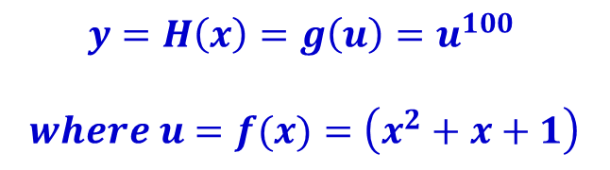
The chain rule: Example
Find H’(x)
Let
Then
$$H\left(x\right)={\left(x^{2}+x+1\right)}^{100}$$
$$y=H\left(x\right)=g\left(u\right)=u^{100}$$ $$where u=f(x)=\left(x^{2}+x+1\right)$$
$$H^{′}\left(x\right)=\frac{dy}{dx}=\frac{dy}{du}.\frac{du}{dx}=100u^{99}\left(2x+1\right)=100{\left(x^{2}+x+1\right)}^{99}\left(2x+1\right)$$

Slide 47
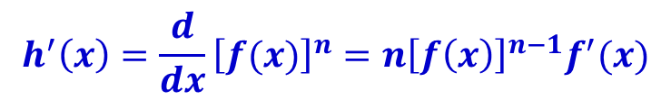

The General Power Rule
Rule 8: The general power rule
If , then
This theorem can be proved using the chain rule (Rule 7).
$$h\left(x\right)={\left[f(x)\right]}^{n}$$
$$h^{′}\left(x\right)=\frac{d}{dx}{\left[f(x)\right]}^{n}=n{\left[f\left(x\right)\right]}^{n−1}f^{′}(x)$$

Slide 48


The general power rule: Example
Find the derivative of:
$$f\left(x\right)=x^{2}{\left(2x^{2}+3\right)}^{5}$$
$$f\left(x\right)={\left(\frac{2x+1}{3x+2}\right)}^{5}$$

Slide 49


The general power rule: Example
Solution:
$$f\left(x\right)=x^{2}{\left(2x^{2}+3\right)}^{5}$$
$$f^{′}\left(x\right)={\left(2x^{2}+3\right)}^{5}\frac{d}{dx}\left(x^{2}\right)+\left(x^{2}\right)\frac{d}{dx}\left[{\left(2x^{2}+3\right)}^{5}\right]$$
$$={\left(2x^{2}+3\right)}^{5}\left(2x\right)+\left(x^{2}\right)5{\left(2x^{2}+3\right)}^{4}\frac{d}{dx}(2x^{2}+3)$$
$$={\left(2x^{2}+3\right)}^{5}\left(2x\right)+\left(x^{2}\right)5{\left(2x^{2}+3\right)}^{4}\left(4x\right)$$ $$={\left(2x\right)\left({2x}^{2}+3\right)}^{4}\left(12x^{2}+3\right)$$

Slide 50


The general power rule: Example
Solution:
$$f\left(x\right)={\left(\frac{2x+1}{3x+2}\right)}^{5}$$
$$f^{′}\left(x\right)=5{\left(\frac{2x+1}{3x+2}\right)}^{4}\frac{d}{dx}\left(\frac{2x+1}{3x+2}\right)$$
$$=5{\left(\frac{2x+1}{3x+2}\right)}^{4}\left(\frac{\left(3x+2\right)2−\left(2x+1\right)3}{{\left(3x+2\right)}^{2}}\right)$$
$$=5{\left(\frac{2x+1}{3x+2}\right)}^{4}\left(\frac{\left(3x+2\right)2−\left(2x+1\right)3}{{\left(3x+2\right)}^{2}}\right)$$ $$=\frac{5{\left(2x+1\right)}^{4}}{{(3x+2)}^{6}}$$

Slide 51
Summary
Describe the definition of the derivative and different notations for the derivative (differentiation).
Introduce to techniques of differentiation (4 steps, 8 rules) with practical and applied examples.
Derivatives of Trigonometric Functions

Slide 52
Homework
Problem Set :
Read sections 2.3, 2.4, 2.5, 2.6 in Chapter 2. Test with some exercises at the end of each section (students should do as much as possible)
Read Study guide for topic 3.
2, 5, 9, 10, 15 -> 18, 23 -> 26, 28 -> 33, 37,39, 40, 41(chapter 2 review exercise) – except the CAS exercises.
References
[1] H. Anton, I. Bivens, S. Davis, Calculus - Early Transcendentals, 9th Ed., MA, USA: John Wiley & Sons, Inc., 2009.

